Slide 1
Steel - the road forward
Nicholas Walters
Notes:
Two years ago now, worldsteel commissioned a global research study to gauge the reputation of the steel industry. The study was conducted in the 10 largest steel using countries of the world and interviewed three main groups of respondents: senior government officials, senior business executives and key global media writing or commenting about steel. The objective was to gauge the view from these groups on the steel industry and steel as a product.

Slide 2
Notes:
The views expressed were more positive than we expected. Where we thought we would find more references to steel as an old and dirty technology applied in a conservative and environmentally insensitive industry, we in fact received far more observations on the importance of steel as a fundamental and useful product and that the industry as a whole is a respected one – though this is more so in some countries than others. What was clear from this feedback was that a common understanding exists about the role of steel in a modern society.
Without steel the modern society could not survive. We believe that the steel industry and steel as a product is a key driver of the modern economy and is essential to the technologies and solutions that meet society’s everyday needs – now and in the future.

Slide 3
Notes:
Steel is everywhere in our lives from current transport systems, infrastructure, housing, manufacturing and agriculture to water and energy supply and clean environments in kitchens and hospitals.

Slide 4
Notes:
But the key word in any discussion about steel is “sustainable”. The steel industry believes that sustainable development must meet the needs of the present without compromising the ability of future generations to meet their own needs. In other words in a successful and thus sustainable green economy economic growth and environmental responsibility works hand in hand. This is why steel is at the heart of the green economy. Renewable energy, resource-efficient and energy efficient buildings and clean energy vehicles and recycling facilities – all these things depend on steel. In addition, many of the challenges posed by population growth, urbanization, poverty reduction and mitigation of natural disasters can best be met by steel.

Slide 5
Notes:
Many everyday products, such as cars, cans and washing machines, are made of steel. Once these products reach the end of their useful lives, the steel is recycled. Recycling reduces the consumption of raw materials and energy and is therefore beneficial for the environment. To understand the environmental performance of a product, its entire life cycle needs to be taken into consideration. A life cycle assessment (LCA) of a steel product looks at resources, energy and emissions, from the raw material extraction phase to its end-of-life phase, including recycling and disposal. LCA can be used to identify priorities for improvements in process operations and product design and development.

Slide 6
Environmental impact: use phase often dominates
% contribution of each life cycle phase
The use phase of products often has the greatest environmental impact
Aim of regulations: to reduce use phase impacts
Steel industry involvement to improve use phase
Material production and end-of-life become more important
Move to lighter weight, higher strength steels
Notes:
In particular, LCA aims to support efforts to develop a consistent, rigorous and transparent methodology to enable society to make informed choices on the environmental impact of products and processes, and to prevent regulators from making decisions based on a lack of information.

Slide 7
Environmental impact: use phase often dominates
% contribution of each life cycle phase
The use phase of products often has the greatest environmental impact
Aim of regulations: to reduce use phase impacts
Steel industry involvement to improve use phase
Material production and end-of-life become more important
Move to lighter weight, higher strength steels
Notes:
For example, it may seem obvious to make decisions concerning vehicle manufacturing based on the reduction of the weight of materials used which leads to reductions in fuel consumption and therefore reduced emissions. However, some of the lightest materials are much more energy and CO2 intensive to produce and are often the most expensive.
Sustainability of the steel industry has both short and longer term drivers. Looking at the medium to longer term trends at least two will be of critical importance.

Slide 8
Global economic trends
Notes:
In the last decade two interconnected themes have dominated the global economic stage. They were underpinned by longer term trends in demographics and urbanisation, but the short term result has been that some economies have proved much more robust than others.

Slide 9
Global growth expected flat in 2013 but developing economies outlook improving
Global GDP developments (%, Real 2005 USD billions)
 | 2009 | 2010 | 2012 | 2013
EU27 | -4.3 | 2.0 | -0.2 | 0.1
NAFTA | -3.2 | 2.6 | 2.3 | 1.9
S.America | -0.3 | 6.0 | 2.3 | 3.3
CIS | -6.8 | 4.9 | 3.6 | 3.6
Africa | 2.7 | 4.7 | 5.0 | 4.4
Middle East | 1.3 | 5.9 | 3.3 | 2.2
Asia | 1.8 | 7.7 | 4.9 | 4.7
Global | -1.9 | 4.2 | 2.6 | 2.5
Source: Global Insight (January 15, 2013), worldsteel
Notes:
Firstly, the financial crisis of 2008 played a seminal role in changing the balance of economic power globally. As a consequence of the financial crisis, a large number of developed economies in the medium term have had to focus on reducing debt levels internally to the detriment of economic growth in their domestic economies. Of the developed economies, only the USA and Germany have to date been successful in reducing internal debt levels substantially. These economies are the ones with best growth potential in the developed economy group in the short term. It has helped that the USA has a relatively young population with enough births to have a replacement rate in the population and that Germany is benefiting from having integrated the old East Germany. Most other developed economies are still some way from recapturing the levels of GDP they enjoyed before 2008.
On the other hand most developing economies shrugged off the 2008 crisis as a short term slowdown and have progressed to levels of GDP and economic growth much higher than the levels they were at in 2008.

Slide 10
Emerging markets drive steel demand at the margin
 | Structure of real GDP & Apparent steel use
 | Developed |  | Developing ex China |  | China
 | GDP | ASC | GDP | ASC | GDP | ASC
2000 | 78% | 56% | 18% | 27% | 3.6% | 16%
2005 | 75% | 40% | 20% | 26% | 5.0% | 33%
2010 | 70% | 24% | 22% | 31% | 7.6% | 45%
2012 | 69% | 23% | 23% | 32% | 8.5% | 45%
Source: Global Insight & worldsteel
Global apparent steel use (Billions of tonnes, finished)
  2012 another record year for apparent steel use
  China’s share of global demand at peak levels
28%
27%
45%
16%
56%
26%
Source: worldsteel
Notes:
Secondly, the power of the sheer pace and drive of China’s robust economic growth has shaped the last decade. The Chinese economy is now officially the second largest economy globally and will probably become the largest somewhere during the next two decades. However the important development for the world is that the Chinese economy, which has grown at rates of around 10% per annum for the past decade driving enormous demand for raw materials and in the process developing into the largest steel producer on the planet, appears to have reached an inflexion point in its growth path. It does not mean that growth will stop, or decline, but merely that growth will be slower in years to come as Chinese society ages and internal growth shifts from the east coast to less populated and less accessible provinces in central and western China. It will also reduce the role that China plays as international consumer of raw materials and other products and consequently China will have over time an increasingly smaller impact on the economic growth performance of the rest of the world.
As China growth slows down, and the developed economies still struggle to reduce debt levels in their economies, there is for the foreseeable future no candidate to step into the position of driver of economic growth on the international stage. India has the population size to influence global demand but is not yet at the level of income per person where it can play an influential role in global economic affairs. Similarly, much is being written about Africa as a potential market, but it will be a while yet before Africa has the organisational maturity and average income levels to have global influence.

Slide 11
Other key trends shaping the industry
Notes:
Apart from the economic environment in which it operates, a number of key trends will shape the steel industry in years to come. These trends provide a mixed bag of opportunities and challenges for the steel industry to deal with. On the positive side the strongest trend is linked to developments in demographics.

Slide 12
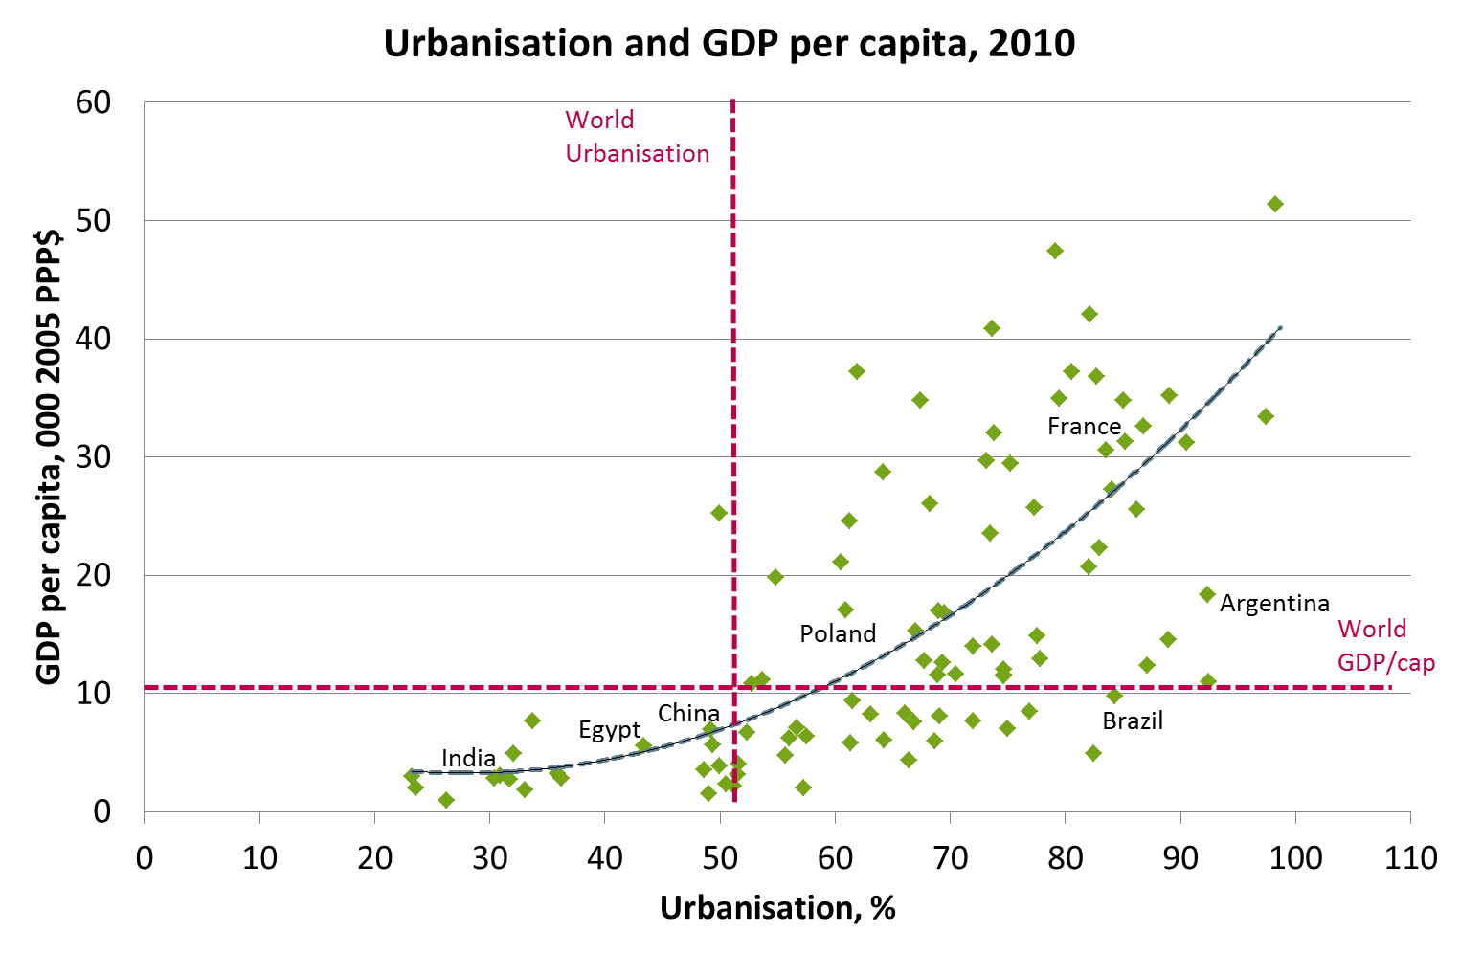
Demographics and its impact on demand
Source: United Nations, worldsteel
Notes:
The world today has 7.1 billion inhabitants. This is expected to grow to 8.3 billion by 2030 and eventually stabilise at between 9 and 9.5 billion inhabitants by around 2050. Of the present inhabitants, 2.5 billion are urbanised, and this is expected to increase to 4 billion by around 2030.

Slide 13
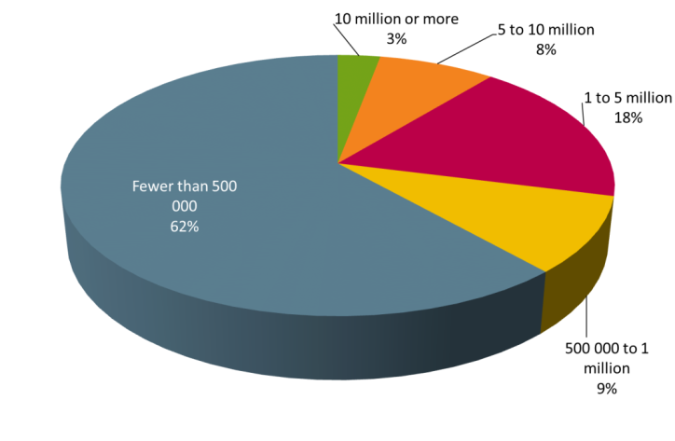
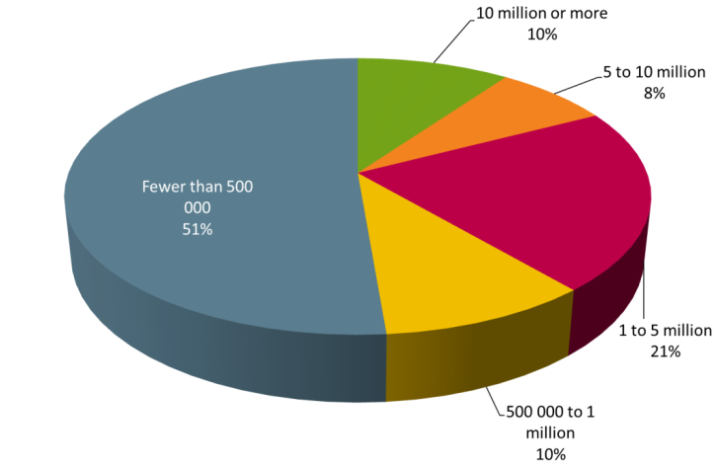
Urbanisation trends indicate concentration to larger cities
Distribution of urban population by type of city:
1970
2010
Source: United Nations
Notes:
On average around 80 million people will move into cities every year, and they will require housing, energy, transportation, food and water. All these activities imply a large and constantly growing demand for steel globally, but importantly in markets where steel has not been used in large volumes in the past. Our own internal research at worldsteel suggests that a positive relationship exists between income per person and urbanisation, with a level of around 8,000 to10,000 US$ per person as a critical level after which urbanisation appears to accelerate. A similar positive relationship between urbanisation and steel use per person exists. Taking these two in combination it would suggest that South-East Asia could be a primary focus for urbanisation in the next decade with Africa below the Sahara to follow thereafter. The opportunities for steel demand in construction flowing from these urbanisation trends are tremendous.

Slide 14
Developing regions more steel intensive in important use sectors
Source: worldsteel
  Urbanisation trends in developing countries contribute to significantly higher steel intensity vis-a-vis developed countries.
  While developing countries are less steel intensive in both industrial and consumer goods.
Notes:
Globally, around 53% of steel production is used in construction applications, with this figure reaching close to 60% in developing markets. In mature markets, where construction uses around 30% of steel production, we are approaching the age where a large part of infrastructure will need to be replaced, creating in itself an interesting future market for steel. Similarly, around 20% of steel produced ends up in the transportation sector, and with an income of 3500 $ per person per year seen as a threshold level for automotive demand to kick off, this could be an interesting market. China has surpassed the threshold with an income of 6000 $ per person per year in GDP and India is fast approaching that level.
With so many countries in the world engaged in development, we believe that steel use in construction will continue to grow strongly in the near future.

Slide 15
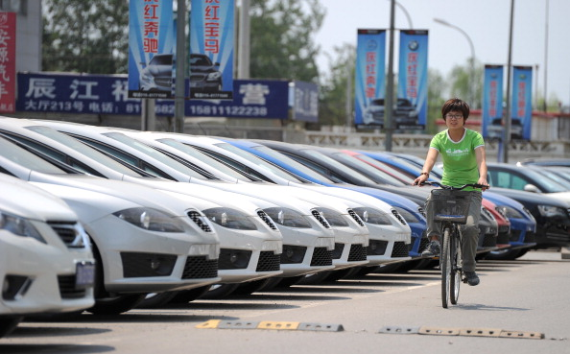
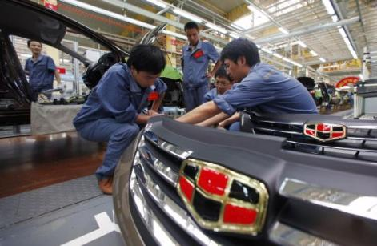
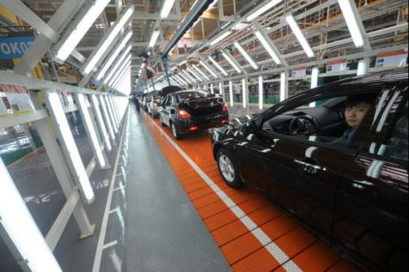
What future for the Chinese automotive sector?
15
Notes:
Automotive data from China is exciting enough. In 2013 car sales are predicted to be above 18 million, against 14.5 million in the USA. But can we predict the future? In the US there are around 600 cars per 1000 people against a global average of 135. In China? Just 44.
Demand levels for products using steel as a major input will continue to grow in the next two decades, creating lucrative opportunities for business involved in the steel value chain.

Slide 16
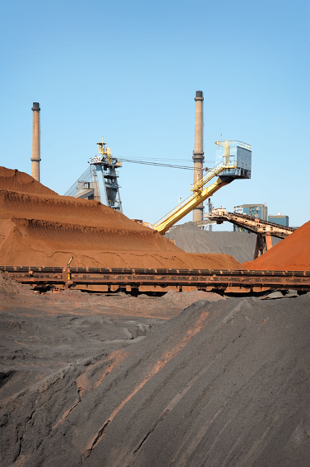
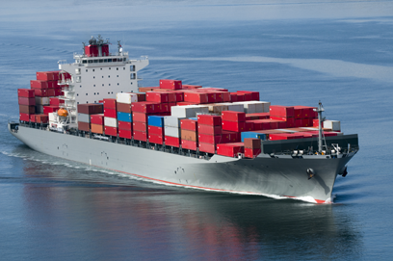
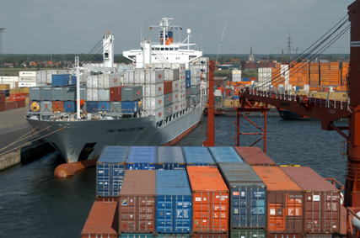
Volatility of raw materials
16
Notes:
The changes in the trade mechanism of steel making raw materials that took place in 2010, from annual contracts to other mechanisms, already have, and will continue to have a significant impact on the steel industry. Raw materials transactions happen at spot market prices and this has a number of impacts.
While the level of prices at which the transactions take place is determined by actions of participants in the market, the volatility of adjustment of these prices makes life difficult for the steel producers. Moreover, with the significant transparency related to transactions of raw materials, the market is quick to adjust to these price levels and this leads to enhanced volatility.
Linked to the volatility in raw materials markets, the transparency creates a further challenge to steel makers. The transparency of raw materials prices, linked to the transparency in finished steel product prices, has made the steel production value chain extremely transparent, contributing to a situation where the steel industry has today largely become an industry converting ore into metals at a transparent and fixed convertors margin. With the industry already efficient in the process of converting ore to metal, very little room exists in the modern industry to absorb the levels of volatility that it is requested to absorb. No tools (such as hedging) exist to offset the volatility to other parties, it will be a considerable number of years before the existing opportunities for hedging are robust and liquid enough to be able to absorb the volumes required from the global steel industry.
Conditions in the raw materials markets are likely to change in the future as the mining industry begins to turn into surplus as new projects come into production, but it will not intrinsically reduce the volatility inherent in the markets, thus providing a continuing challenge to steel makers.

Slide 17
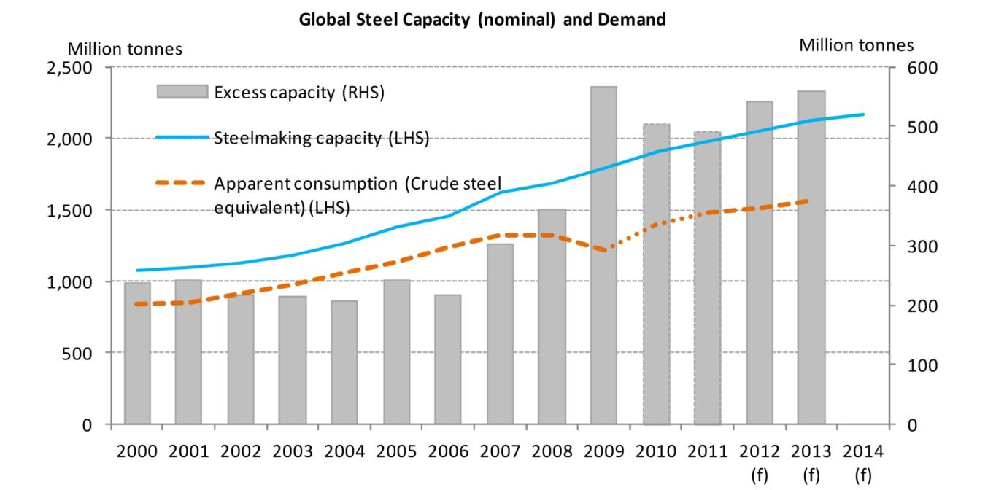
Steelmaking capacity
Source: OECD
17
Notes:
A recent study by the OECD (released in December 2012) indicates that a large amount of surplus capacity exists in the steel producer community today. According to this study, as much as 570 million tons of surplus capacity has been installed against the estimated demand levels. The distribution of this excess capacity is all over the world with around 50% of the surplus existing in China. China has announced a 5 year programme of industry consolidation and closure of ageing and redundant capacity. However important countries in developed Asia (Japan, Korea), plus the CIS and EU all have large amounts of excess capacity as well and are struggling with decisions.
Two key problems need to be solved. Firstly, should steel makers try to address the level of excess capacity then significant barriers to exit exist; including requirements for reducing labour forces, insistence on rapid rehabilitation of production sites often at prohibitive cost and political opposition to closure of excess steel facilities. Steel makers can in the short term only react by becoming more flexible in how capacity is being used, which itself contributes to volatility in the steel and steel making raw materials markets.
Secondly, countries continue to view steel as a strategic sector and consequently new capacity continues to be planned, despite the fact that surplus capacity exist. It is true that capacity may not exist locally but the dynamic is that capacity is looked at only on a national level not a regional or global level. This is unsustainable.

Slide 18
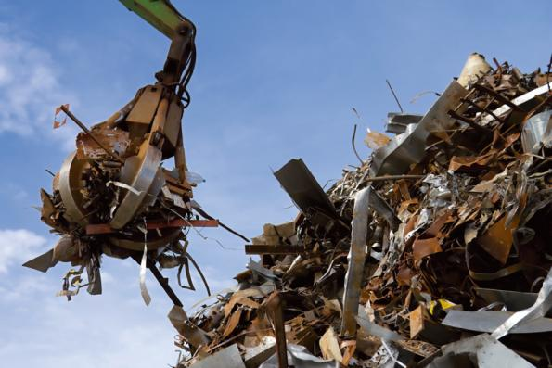
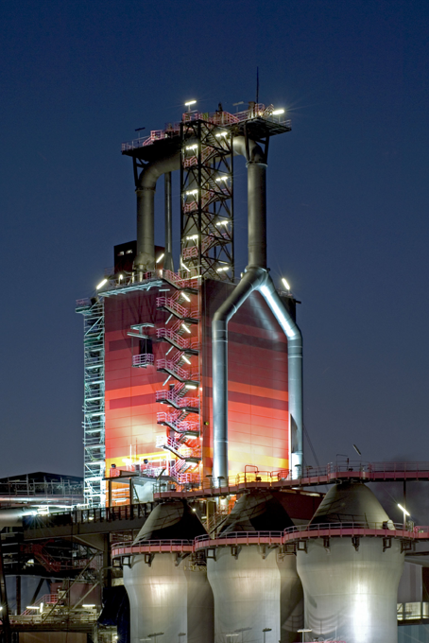
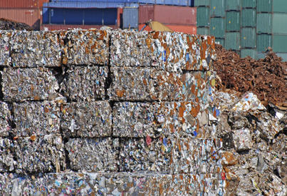
Changes in technology
18
Notes:
Scrap generation in recently developed steel producing countries will increase in the future. Today around 400 million tons of scrap steel is recycled annually. Of this only around 70 million is collected and recycled in China. It is expected that scrap generation in China could increase rapidly in years to come, as scrap generation follows steel production with a lag period. In fact, the world is fast approaching the point where the logical decision would be to maintain existing metal from ore facilities, but to focus any new facilities to a technology that can absorb scrap metal as a feedstock. The reality is that energy shortages exist also in many fast developing economies and as a result they may not have enough available for scrap melting technology. The future will however gradually tilt towards more scrap melting technologies rather that away from it.
In the short term, abundance of new energy resulting from shale gas exploration and development particularly in the USA, could lift the development and use of Direct Reduced Iron (DRI) as a new metallic source, but it is uncertain if this trend will migrate to other markets. In the final analysis, the availability of a regular and affordable amount of electricity would determine if scrap melting technology would be utilised in any specific country.
In the longer term, future steelmaking technology will need to address two questions – making steel with lower carbon emissions, and absorbing more scrap as part of the steelmaking process. Technology for absorbing more scrap already exists in the form of the EAF, but this is in many cases still dependent on electricity generated from burning fossil fuel with carbon emission as a by-product. It is not unlikely that experimentation with absorbing more scrap in the BOF process will accelerate. If successful, this may develop into a “hybrid” technology using more scrap, but without the requirement of an external energy (electricity) and will therefore not increase emissions associated with energy generation. This is not a short term development and will require as a first pre-condition the supply of scrap to increase. This will take some time.
Energy remains a key challenge. Over a 30 year period the steel industry has reduced its energy consumption per tonne of steel by 50%. However due to this dramatic improvement in energy efficiency there is not much room left for more efficiency based on existing technology. The need for major expenditure on research and development to identify breakthrough steelmaking technologies must have significant government financial contribution.

Slide 19
The future
Notes:
We are nowhere near the limit of steel demand in the future - demand can still expand by a good 500 million tonnes and at the present rate of use growth, this could take a good decade of growth before we will begin to see stabilisation in demand. Some people are predicting a peak around 2.5 billion tonnes per year by 2050. Investment decisions we in the industry make now, will probably last well into the period of stabilized demand.

Slide 20
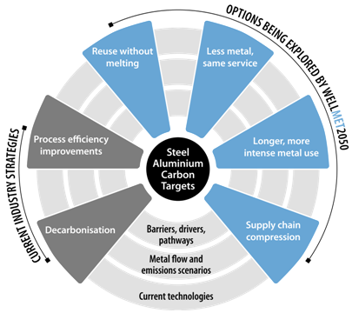


Design requirements
Notes:
So having addressed the challenges what do we think lies ahead? Three main patterns emerge and for this I have heavily relied on an excellent study called “Sustainable Materials – with both eyes open” by Julian Allwood and his fellow contributors at Cambridge University.

Slide 21
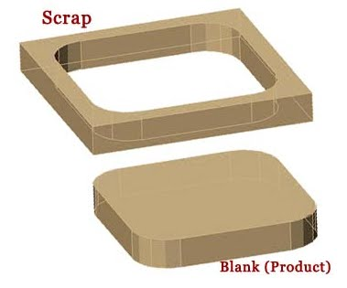
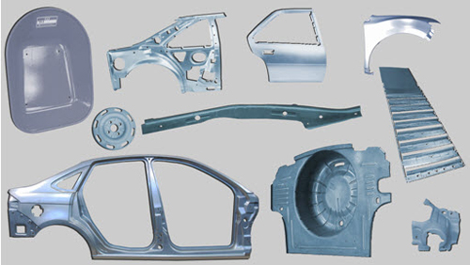
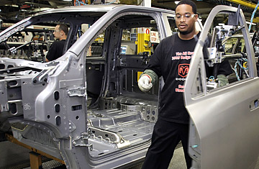
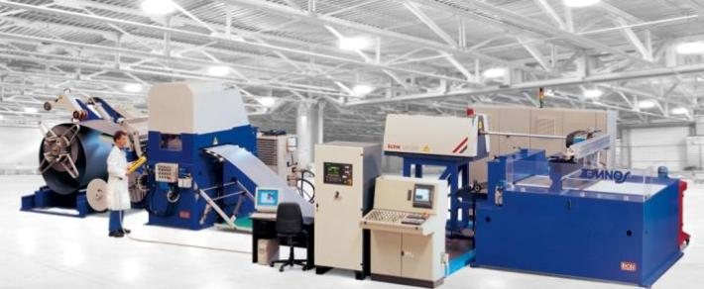
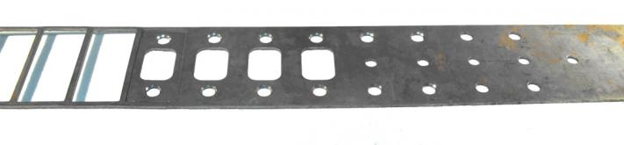
Efficient and optimised production processes
21
Notes:
Firstly the steel industry is already engaged in major programmes with its customers to radically reduce the amount of steel used in key products. For example new designs using Advanced High Strength Steel in the automotive sector are predicting future mass savings of up to 39%, compared to a baseline steel body structure from today carrying an internal combustion engine. The new Future Steel Vehicle programme as it is called has been designed using a battery-electric powertrain and includes year 2020 regulatory requirements. This will make steel comparative to aluminium in terms of weight, at a much lower cost but still more than meeting all safety standards. An additional benefit for steel is that the life cycle costs of steel, measured by energy consumption or carbon emissions, is significantly lower than competitive materials in the automotive industry.
Similar changes can be forecasted for the construction industry where many steel materials are specified at fixed and regular grades. These have mostly been designed for production simplicity rather than actual weight requirement. So beams are straight and have constant depth when actually variable-sectioned beams would suit the purpose better and be far more material efficient. As Julian Allwood says we will more aggressively seek out optimal use of steel. More intelligent use of steel will allow the industry to charge higher margins, but the customer will be making a saving on purchasing less steel.

Slide 22
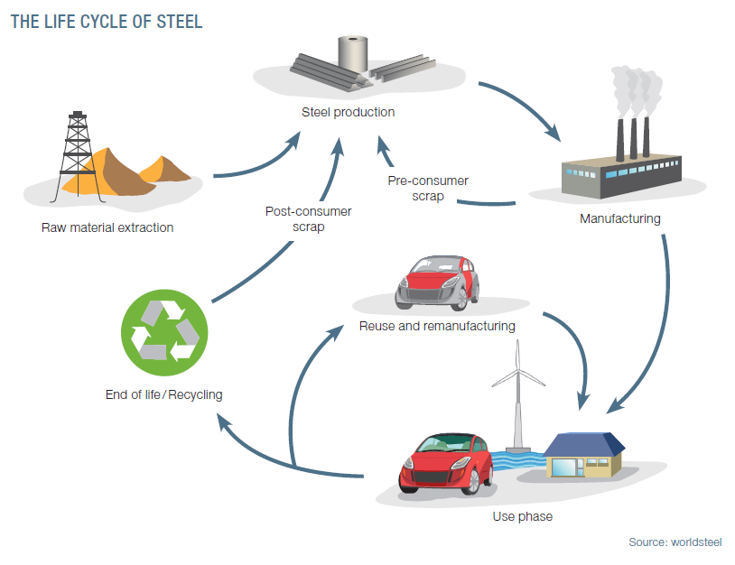
Sustainability must apply over the life cycle of steel
- Not possible without supply chain collaboration
Notes:
Secondly we can expect much greater efficiency in our production processes. The example given above will require flexible long rolling processes. The focus shifts from process efficiency to product efficiency. Invented in laboratories but not yet used commercially, the approach may also in future be applied in Flexible blanking or stamping lines. Why stamp a car door and then return over a third of the metal sheet to scrap to be recycled and put through the identical process again? Inefficient and costly.
Thirdly and finally we can expect much greater reuse of components. Buildings can be designed with reuse specifically in mind so that for example after the 40 year life of a building it is not simply raised to the ground but carefully disassembled and the major steel elements saved and reused. This could be a substantial business opportunity for the steel industry to take control of its own second hand market.
The steel industry does not sit still and is adapting and evolving at the same pace as its customers. As has been the case throughout history, innovations in steel will always play a vital role in helping mankind meet its future challenges.

