Slide 1
A Decade of “Pain” to follow a Decade of “Gain?”
CANACERO
September 11, 2013

Slide 2
Four Mega-Trends Will Determine the Outlook
Slower demand growth, economic uncertainty, overcapacity and increased competition are likely to result in a difficult environment for the steel industry through 2015-2017 and perhaps beyond. Chinese steel demand growth an increasingly important “wildcard.”
End of steel’s “Age of Metallics”
“Flattened” cost curve exacerbating the competition for the last tonne and delaying output cuts by steel mills. Currency weakness in Developing World ex-China adding a new wrinkle.
Is anyone prepared for the massive avalanche of Chinese steel scrap in the decade ahead, along with the accompanying ramifications on the global industry structure?
Notes:
Interestingly, these four topics, or Mega-Trends if you wish, are something I have been discussing at a number of conferences since the latter part of 2012. The truth is, despite all the new developments since that period, these four items have become ever more prominent on my mind during that time and their importance is only likely to grow going forward in WSD’s opinion.

Slide 3
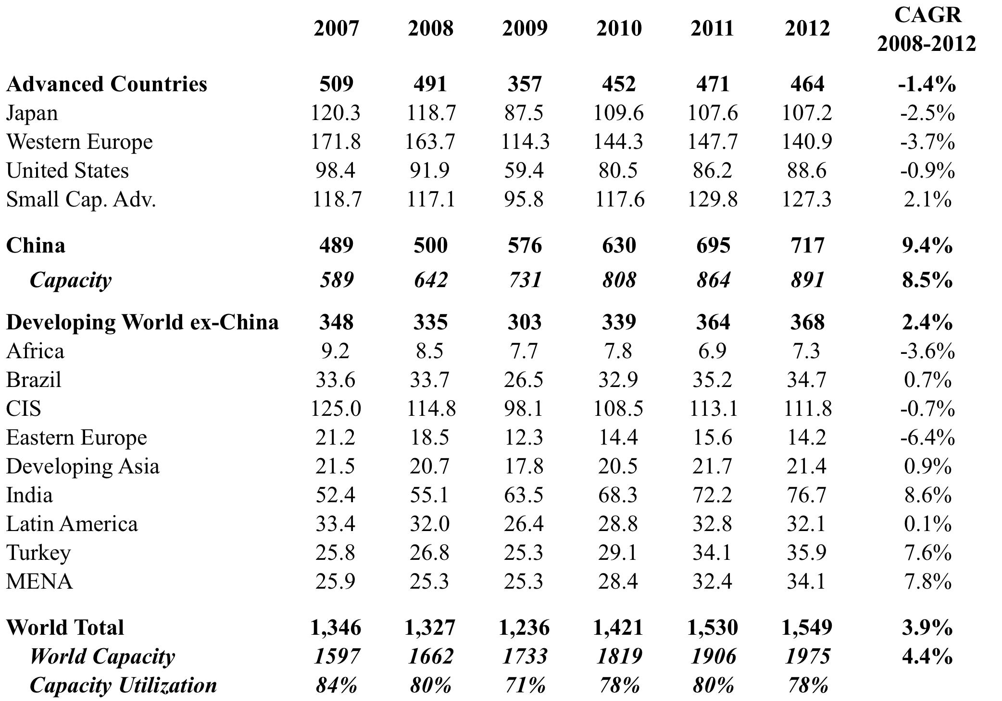
Unbalanced Global Steel Demand & Output

Slide 4
Fixed Asset Investment = Key Driver of Steel Demand

Slide 5
Chinese Steel Intensity for
FAI and Household Consumption

Slide 6
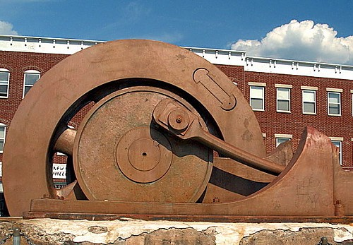
Don’t Underestimate the
Power of the “FAI Flywheel”

Slide 7
Global FAI vs. Apparent Steel Consumption

Slide 8
Advanced Countries FAI v. ASC
(Absolute Figures)

Slide 9
Developing World ex-China FAI vs. ASC

Slide 10
China FAI v. ASC
(Absolute Figures)

Slide 11
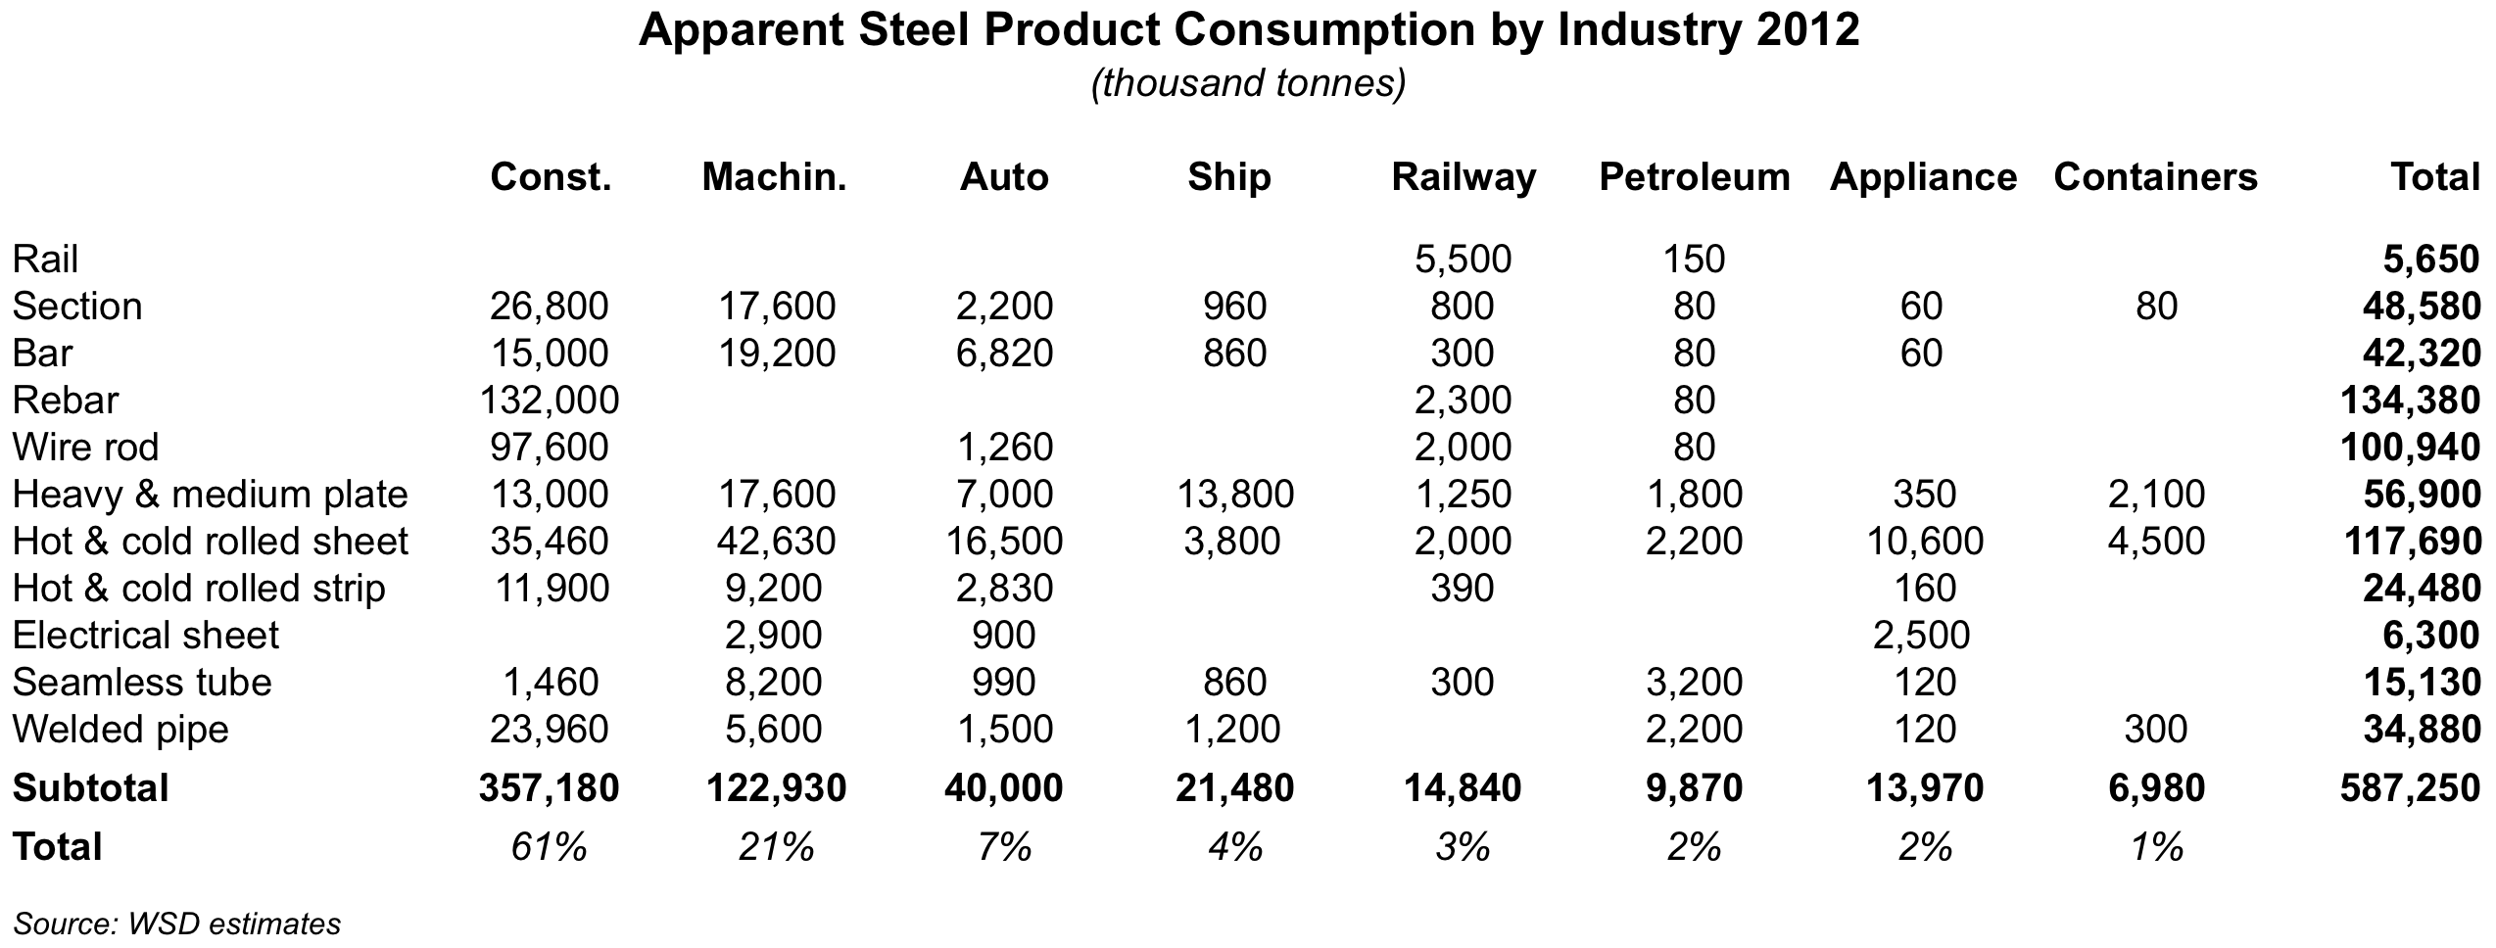
Chinese Construction Market
“House of Cards?”

Slide 12
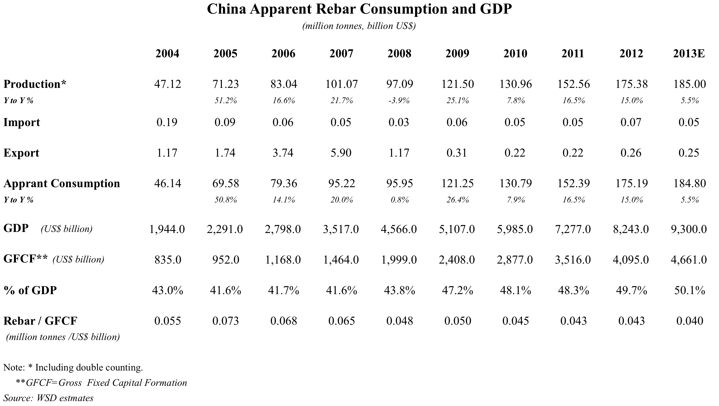
Chinese Construction Market
“House of Cards?”

Slide 13
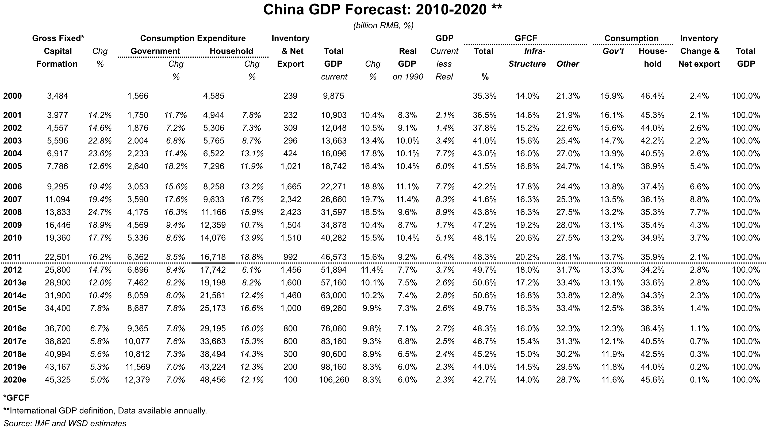
China FAI Long-Term Outlook
Increased consumption (and reduced FAI) as a share of GDP likely to mean much slower steel demand growth (outright contraction??)

Slide 14
India v. China
Minimizing Potential

Slide 15
India v. China
Minimizing Potential

Slide 16
India v. China
Minimizing Potential

Slide 17
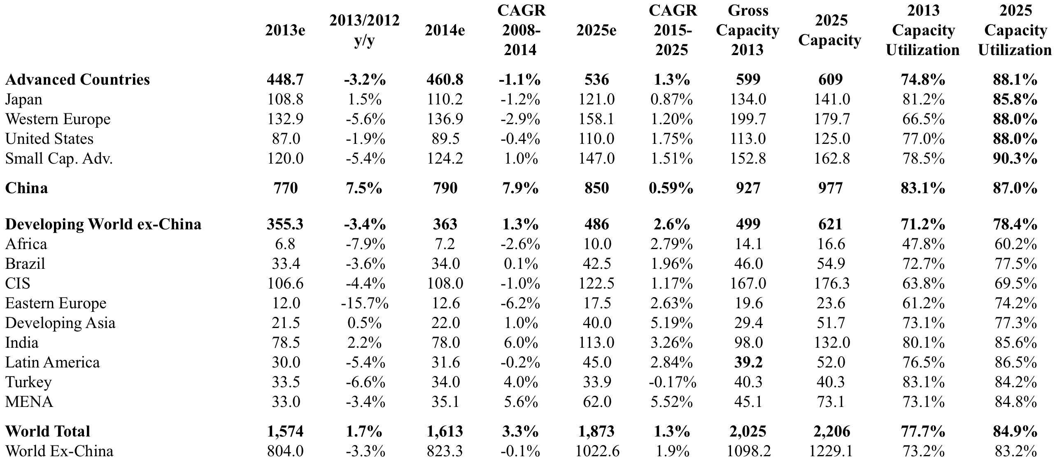
Global Steel in the Decade Ahead:
Continued Slow Growth

Slide 18
Four Mega-Trends Will Determine the Outlook
Slower demand growth, economic uncertainty, overcapacity and increased competition are likely to result in a difficult environment for the steel industry through 2015-2017 and perhaps beyond. Chinese steel demand growth an increasingly important “wildcard.”
End of steel’s “Age of Metallics”
“Flattened” cost curve exacerbating the competition for the last tonne and delaying output cuts by steel mills. Currency weakness in Developing World ex-China adding a new wrinkle.
Is anyone prepared for the massive avalanche of Chinese steel scrap in the decade ahead, along with the accompanying ramifications on the global industry structure?
Notes:
Interestingly, these four topics, or Mega-Trends if you wish, are something I have been discussing at a number of conferences since the latter part of 2012. The truth is, despite all the new developments since that period, these four items have become ever more prominent on my mind during that time and their importance is only likely to grow going forward in WSD’s opinion.

Slide 19
Global Steel Production & Methodology:
China Driving the “Bus”
China’s prodigious and rapid growth via the BF/Integrated route
changed the landscape of global steel production

Slide 20
Global Iron Ore Demand
∆ = 697 Million tonnes
Global iron ore demand has increased 703 million tonnes since 2003, of which China has accounted for 669 million tonnes (95%).

Slide 21
Chinese Iron Ore Supply
Domestic production has increased 7.7% CAGR since 2000, while imports have grown 22% CAGR and account for 61% of the total requirement.

Slide 22
Iron Ore Price and Demand
While Chinese demand increased 198% (14.6% CAGR) since 2003,
the price of ore delivered to China has increased 293% (18.7% CAGR).

Slide 23
Capacity Expansion Pipeline
Running Away from Demand

Slide 24
Chinese Domestic Iron ore
Production Cost
Chinese “high-cost” production may amount to only ~75 million tonnes – a figure that is easily displaced by lower-cost imported material

Slide 25
Global Iron ore
Production Cost
Chinese “high-cost” production may amount to only ~75 million tonnes – a figure that is easily displaced by lower-cost imported material

Slide 26
Four Mega-Trends Will Determine the Outlook
Slower demand growth, economic uncertainty, overcapacity and increased competition are likely to result in a difficult environment for the steel industry through 2015-2017 and perhaps beyond. Chinese steel demand growth an increasingly important “wildcard.”
End of steel’s “Age of Metallics”
“Flattened” cost curve exacerbating the competition for the last tonne and delaying output cuts by steel mills. Currency weakness in Developing World ex-China adding a new wrinkle.
Is anyone prepared for the massive avalanche of Chinese steel scrap in the decade ahead, along with the accompanying ramifications on the global industry structure?
Notes:
Interestingly, these four topics, or Mega-Trends if you wish, are something I have been discussing at a number of conferences since the latter part of 2012. The truth is, despite all the new developments since that period, these four items have become ever more prominent on my mind during that time and their importance is only likely to grow going forward in WSD’s opinion.

Slide 27
Wide Disparities between the
“Haves” & “Have Nots”
Despite rising I.O. and coal costs, Indian producers are well-positioned to remain among the lowest cost well into the future

Slide 28
Stronger US Dollar to Have Numerous Ramifications

Slide 29
WSD’s World Cost Curve for
Hot-rolled Band (Including overhead)
Flattening of the cost curve promotes increased competition and delays production cutbacks when the price plummets below the marginal cost of the high-cost producer

Slide 30
World ex-China
Hot-rolled Band (Including overhead)
WSD’s World Cost Curve has flattened substantially
since the peak cost period in July 2011.

Slide 31
China
Hot-rolled Band (Including overhead)
Despite a decline in costs from recent peaks,
Chinese producers remain in a difficult position

Slide 32
Four Mega-Trends Will Determine the Outlook
Slower demand growth, economic uncertainty, overcapacity and increased competition are likely to result in a difficult environment for the steel industry through 2015-2017 and perhaps beyond. Chinese steel demand growth an increasingly important “wildcard.”
End of steel’s “Age of Metallics”
“Flattened” cost curve exacerbating the competition for the last tonne and delaying output cuts by steel mills. Currency weakness in Developing World ex-China adding a new wrinkle.
Is anyone prepared for the massive avalanche of Chinese steel scrap in the decade ahead, along with the accompanying ramifications on the global industry structure?
Notes:
Interestingly, these four topics, or Mega-Trends if you wish, are something I have been discussing at a number of conferences since the latter part of 2012. The truth is, despite all the new developments since that period, these four items have become ever more prominent on my mind during that time and their importance is only likely to grow going forward in WSD’s opinion.

Slide 33
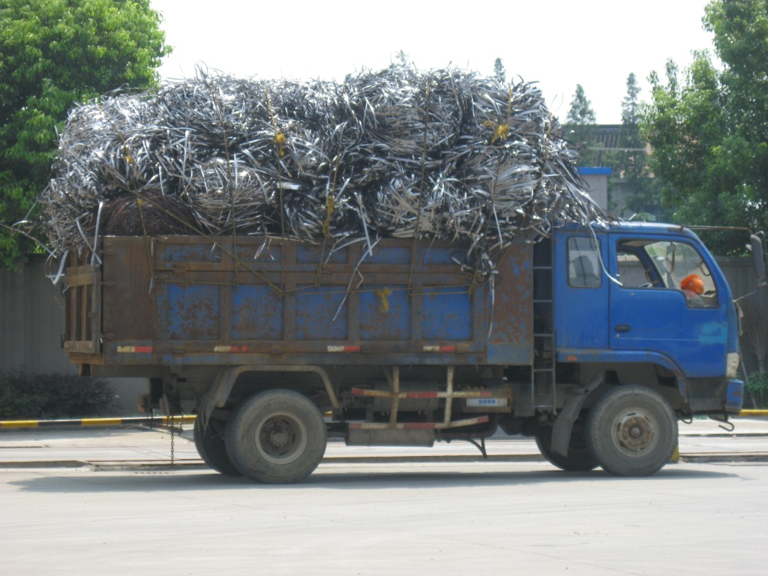
Chinese Scrap Overload

Slide 34
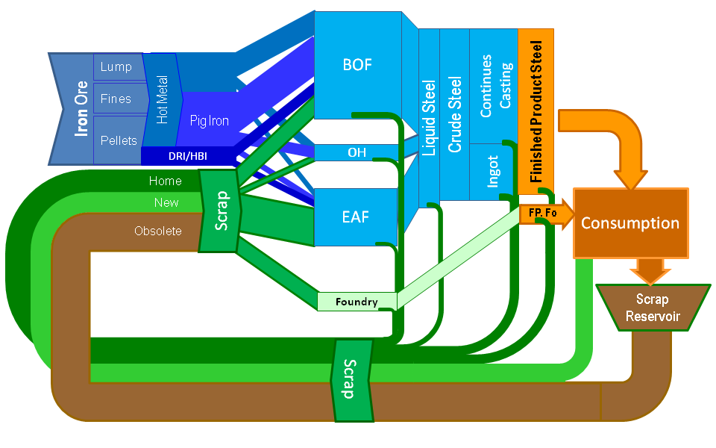
Steelmakers’ Metallics

Slide 35
Global Steel Scrap Demand
Obsolete steel scrap demand was 358 million tonnes in 2011 and the recovery rate was the highest on record. In 2012, the obsolete scrap requirement was flat at 358 million tonnes implying a 0.94 recovery rate from the obsolete scrap reservoir that is on average 10-40 years old.

Slide 36
Global Steel Scrap Supply
Advanced and Industrialized Developing Economies have been the dominant source of steel scrap supply [growth] in the past 30+ years

Slide 37
Global Steel Scrap:
Price versus Recovery Ratio
WSD analysis indicates that the obsolete scrap recovery rate and the price of shredded scrap price are highly correlated with a 0.90 coefficient of correlation.

Slide 38
2013 Metallics Requirements

Slide 39
2025 Metallics Requirements

Slide 40
Chinese Obsolete Scrap:
Supply-Demand Balance
2012 Demand and Reservoir: 63 million tonnes and 57 million tonnes
2025 Demand and Reservoir: 67 million tonnes and 220 million tonnes

Slide 41
Chinese Obsolete Scrap:
Increase BOF Scrap Ratio from 14.5% to 20%
2012 Demand and Reservoir: 63 million tonnes and 57 million tonnes
2025 Demand and Reservoir: 101million tonnes and 220 million tonnes

Slide 42
Chinese Obsolete Scrap:
Increase both EAF share of crude steel production to 20% of all Chinese production
2012 Demand and Reservoir: 63 million tonnes and 57 million tonnes
2025 Demand and Reservoir: 103 million tonnes and 220 million tonnes

Slide 43
Chinese Obsolete Scrap:
Increase both EAF and BOF related consumption
2012 Demand and Reservoir: 63 million tonnes and 57 million tonnes
2025 Demand and Reservoir: 131 million tonnes and 220 million tonnes

Slide 44
Chinese Obsolete Scrap:
Are you ready for arrival?
2013 Demand and Annual Reservoir: 68 million tonnes and 57 million tonnes
2035 Chinese Annual Reservoir: 400 million tonnes

Slide 45
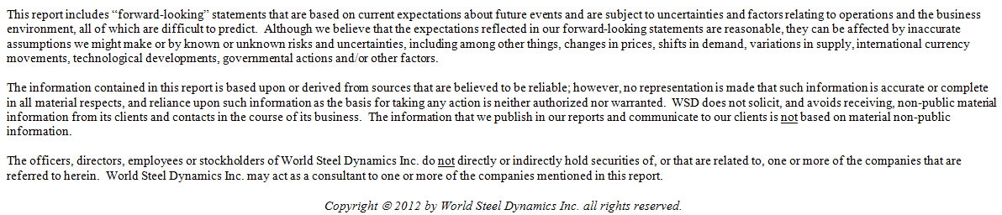
Thank You

